Slide 1

Joint Position Statement on Medical Publications, Preprints, and Peer Review.
Dikran Toroser, PhD CMPP
On behalf of AMWA-EMWA-ISMPP
Joint Position Statement Committee

Slide 2
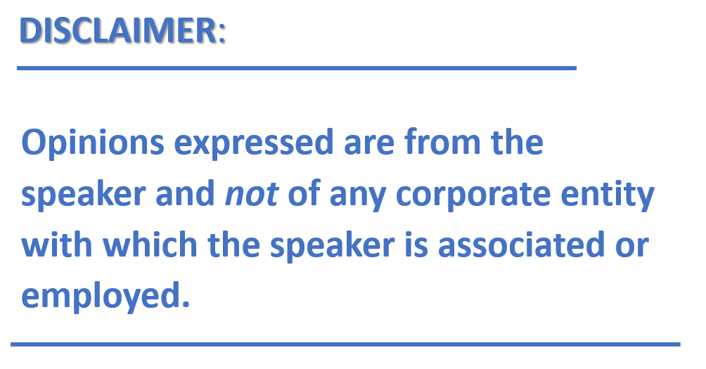

Slide 4
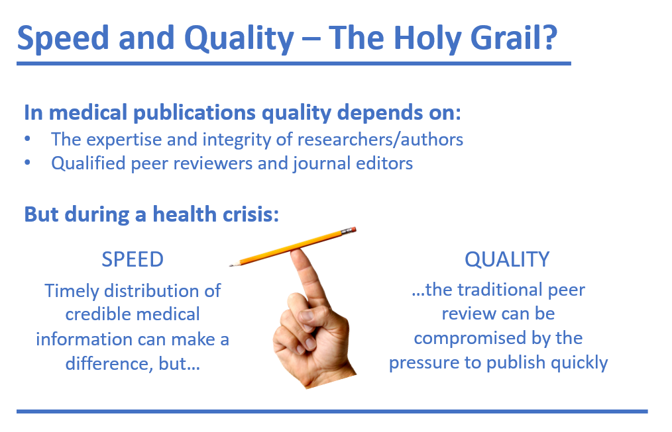

Slide 6
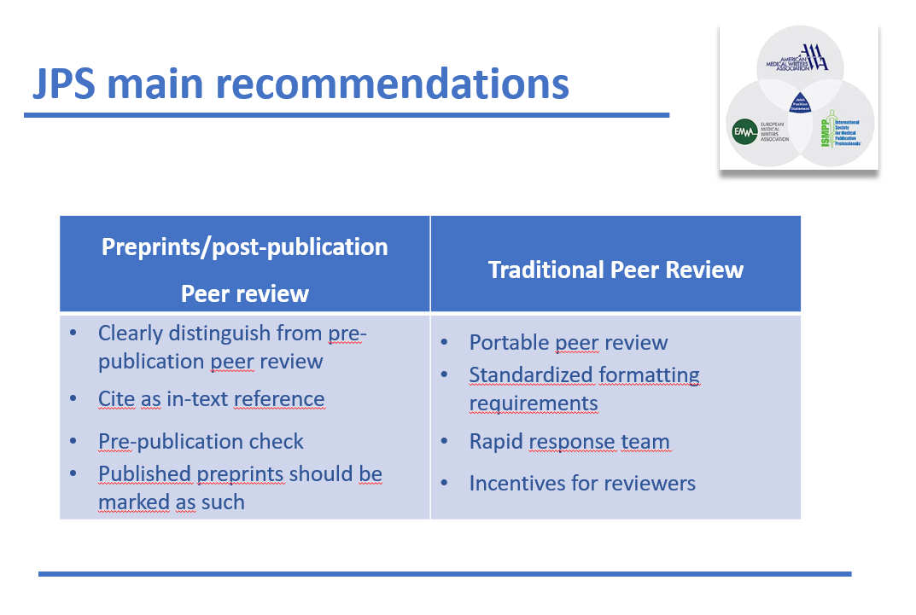

Slide 8
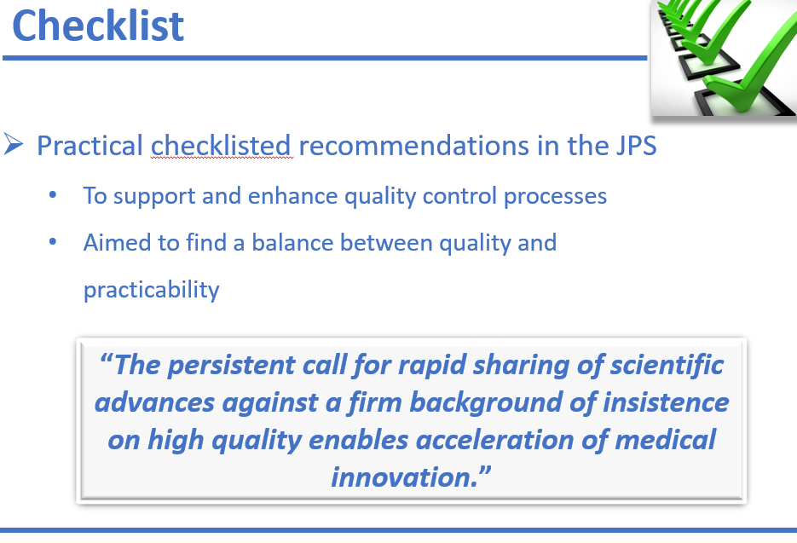

Slide 9
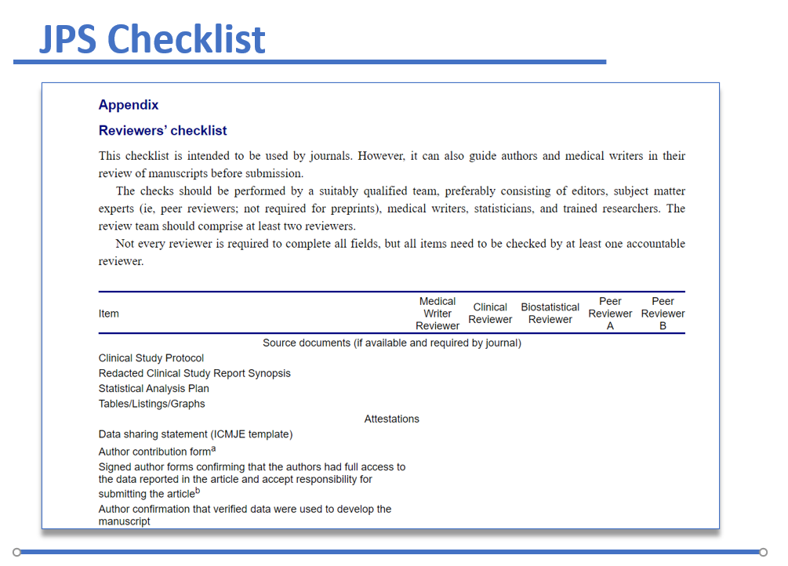

Slide 10
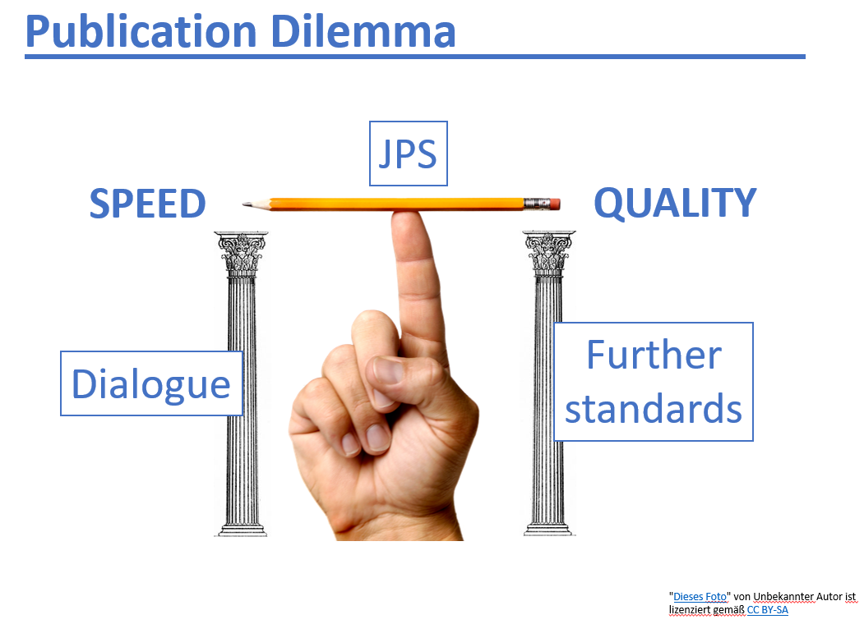

Slide 12
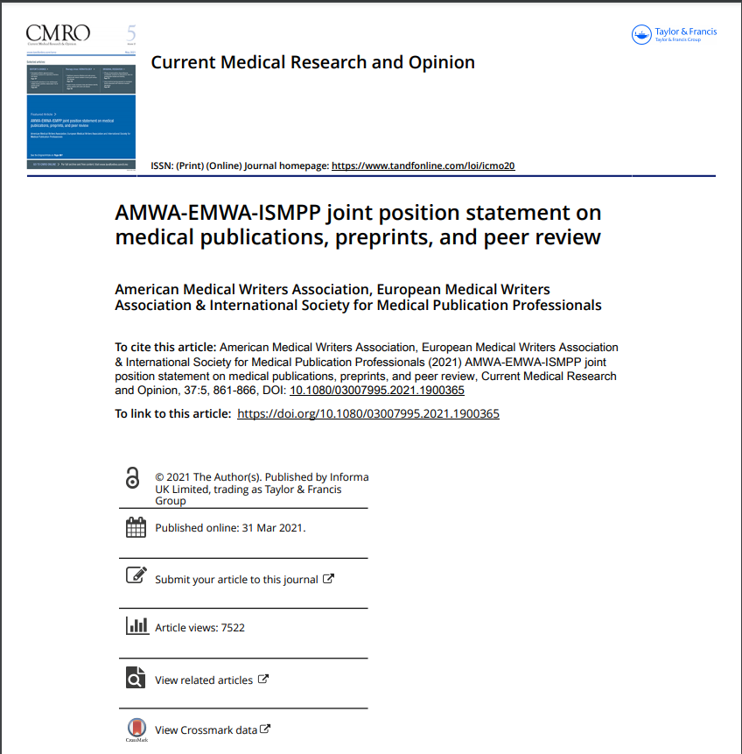
https://doi.org/10.1080/03007995.2021.1900365

